Slide 1
Healthcare Ministry: Commissioned and Constrained
The Tale of Two Christian Communities

Slide 2
“Extending the Healing Ministry of Christ” --The Mission of AdventHealth
“It [the mission] calls us to be His hands and feet in helping people feel whole. Our story is one of hope — one that strives to heal and restore the body, mind and spirit.”
“Our calling is to provide whole-person care that tends to body, mind and spirit, just as Christ did during His earthly ministry.”
https://www.adventhealth.com/who-we-are retrieved 10-28-2020
Does this mission leading to wholeness include extending Christ’s invitation, “Come, follow Me”?

Slide 3
Jesus’ Invitation
Come to me, all you who are weary and burdened, and I will give you rest….for I am gentle and humble in heart, and you will find rest for your souls.” (Mat 11:28-30 NIV)
Should AdventHealth convey this invitation?
If so, how?

Slide 4
Jesus’ Orders: The Gospel Commission
“All authority in heaven and on earth has been given to me. Therefore go and disciple all the nations, baptizing them in the name of the Father and of the Son and of the Holy Spirit, and teaching them to obey everything I have commanded you.” (Matthew 28:18-20)

Slide 5
An earlier 20th century Adventist perspective
“…[E]very physician….should labor as one of God’s ministers, to teach repentance and salvation of soul and body….”
Ellen G. White Counsels on Health (1923), p 544, reprinted in Medical Ministry 1932), p. 247

Slide 6
David Levy, MD. Author of Gray Matter: A Neurosurgeon Discovers the Power of Prayer . . . One Patient at a Time
https://www.risenmagazine.com/david-levy-m-d/

Slide 7
Crucial Questions Today
What role(s) should a Christian-based healthcare system and its employees embrace in 2020 in helping fulfill the Gospel Commission?
What practical and ethical constraints impact AdventHealth in fulling the Gospel Commission?

Slide 8
Realities: A short list for AdventHealth
Primacy of patient autonomy—patients come with their own faith
Recognition of the power differential between patient & professional
Religiously diverse employees and physicians
Religiously diverse community constituency in a competitive market
Short-term hi-tech care rather than lengthy sanitarium care
Impact of lower patient mortality rate
Chaplain as trained spiritual hospitalists

Slide 9
Opportunities for Mission
Prayer is encouraged, proselytizing is not
But ask before offering prayer
Team huddles, providing spiritual support and encouragement
Captivating artwork on biblical themes and scriptural selections
The AdventHealth assessment that includes queries on love, joy, and peace with follow-up for patients at risk
Could there be more?

Slide 10
An Unexpected Ally: The New Testament
All twenty-one letters in the NT to scattered Christians worshipping in urban house churches throughout the Mediterranean address how these Christians should live in the world, including how to “witness” to their faith in Jesus.
A close look fails to find any directive to evangelize their non-Christian neighbors by taking the initiative to preach Jesus or confront their neighbors with the claims of the Gospel.
To repeat, there are none!
Let’s look at a brief survey of the evidence:

Slide 11
Realities the Early Church Faced
Pliny, Governor of Bithynia to Emperor Trajan, c. 110 AD
Meanwhile, in the case of those who were denounced to me as Christians, I have observed the following procedure: I interrogated these as to whether they were Christians; those who confessed I interrogated a second and a third time, threatening them with punishment; those who persisted I ordered executed….Accordingly, I judged it all the more necessary to find out what the truth was by torturing two female slaves who were called deaconesses. But I discovered nothing else but depraved, excessive superstition. --

Slide 12
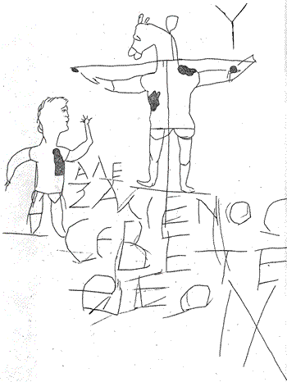
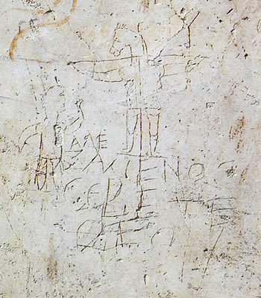
Alexamenos you (pl.) worship [show allegiance] to god

Slide 13
Realities, continued...
No place of worship except private homes
Viewed as
Followers of a Christos pretender, causing riots among the Jewish population
Giving allegiance to a crucified criminal as a deity, soon to return to overthrow the Roman empire
Endangering the world by refusing to honor the legitimate protecting deities
Attracting the lowest classes and slaves
Breaking up families and subverting the social hierarchy
Engaged in secret sex scandals

Slide 14
Roman Christians’ Good Neighbor Policy
. Do not repay anyone evil for evil. Be careful to do what is right in the eyes of everybody. If it is possible, as far as it depends on you, live at peace with everyone. Do not take revenge, my friends, but leave room for God's wrath, for it is written: "It is mine to avenge; I will repay," says the Lord. On the contrary: "If your enemy is hungry, feed him; if he is thirsty, give him something to drink. In doing this, you will heap burning coals on his head." Do not be overcome by evil, but overcome evil with good.
Give everyone what you owe him: If you owe taxes, pay taxes; if revenue, then revenue; if respect, then respect; if honor, then honor. Let no debt remain outstanding, except the continuing debt to love one another, for he who loves his fellowman has fulfilled the law. The commandments, "Do not commit adultery," "Do not murder," "Do not steal," "Do not covet," and whatever other commandment there may be, are summed up in this one rule: "Love your neighbor as yourself." Love does no harm to its neighbor. Therefore love is the fulfillment of the law. Romans 12 and 13

Slide 15
Believers in Colossae: Wait until they ask…
Be wise in the way you act toward outsiders; make the most of every opportunity. Let your conversation be always full of grace, seasoned with salt, so that you may know how to answer everyone.
--Colossians 4:5-7

Slide 16
Earning Respect in Thessalonica
Make it your ambition to lead a quiet life, to mind your own business and to work with your hands, just as we told you, so that your daily life may win the respect of outsiders and so that you will not be dependent on anybody.
--1 Thessalonians 4:11-12

Slide 17
Showing Respect in Asia Minor
Dear friends, I urge you, as aliens and strangers in the world, to abstain from sinful desires, which war against your soul. Live such good lives among the pagans that, though they accuse you of doing wrong, they may see your good deeds and glorify God on the day he visits us…. Live as free men, but do not use your freedom as a cover-up for evil; live as servants of God. Honor everyone, love the brotherhood of believers, fear God, honor the king.
--1 Peter 2:9 -3:12

Slide 18
Jesus’ Sermon on the Mount The Crown Jewel
Vital for any consideration of mission by a Christian corporation.
Second person plural pronouns and verbs
Moves from establishing the corporate identity and mission (5:3-16) to strategy (5:17-6:18) to support and policies (6:19-7:23).

Slide 19
Corporate and Market Identities
You (pl) are the salt of the earth. But if the salt loses its saltiness, how can it be made salty again? It is no longer good for anything, except to be thrown out and trampled by men. You (pl) are the light of the world. A city on a hill cannot hide. --Matthew 5:13-14

Slide 20
Identity Symbols for Residential Believers
You (pl) are the light of the world. A city on a hill cannot be hidden. Neither do people light a lamp and put it under a bowl. Instead they put it on its stand, and it gives light to everyone in the house --Matthew 5:14-16 NIV

Slide 21
Corporate Mission
In the same way, let your (pl) light shine before men, that they may see your(pl) good deeds and praise your Father in heaven.
Matthew 5:16
What kind of good deeds does Jesus have in mind?

Slide 22
The “good works” that win
Healthy relationships within the family of faith (5:21-26).
Self-control of one’s inner universe (5:28-30).
Marital stability and faithfulness (5:31-32)
Truth-telling and integrity(5:33-37)
Unexpected, creative & undeserved acts of kindness (5:38-42)
Prayer on behalf of the enemy (5:43-48)

Slide 23
Not to be on display: Traditional Piety
No Conspicuous
religious offerings
religious rituals
displays of prayer
(Matthew 6:1-19)
Ethical integrity under pressure wins over mere religiosity

Slide 24
A tale of two Kingdom outposts
1st century faith-based house churches and 21st century faith-healthcare corporations
Both with a mission mandate growing out of allegiance to Jesus Christ
Both under pressure to avoid direct evangelism, though with different impediments and social standing
Both permanently embedded in local communities like a city on a hill
Regardless of challenges, the demand for viable strategies to achieve the mission remains.

Slide 25
Needed: A Translation of Matthew 5:18-48
If Jesus were speaking to faith-based healthcare corporations and providers, what..
strategic initiatives might he suggest?
corporate ethos and ethical standards would he support?
leadership style would he expect?
relationships with competitors would he approve?
…as the “good works” (Matthew 5:16) that can lead others to entrust themselves to Him in 2020?

Slide 26
The Adventist Emphases
Would the AdventistHealth Board of Trustees be satisfied if the ministry of AdventHealth employees led to the acceptance of Jesus as Lord but not to membership in the Seventh-day Adventist church?
Which Adventist beliefs and practices could serve to enhance the mission of bringing wholeness and healing?

