Slide 1
“Big Data:” What Do We Do With IT?
Center for Population Health Research
Department of Health and Biomedical Sciences
J. Russ Butler & Craig Gillen

Slide 2
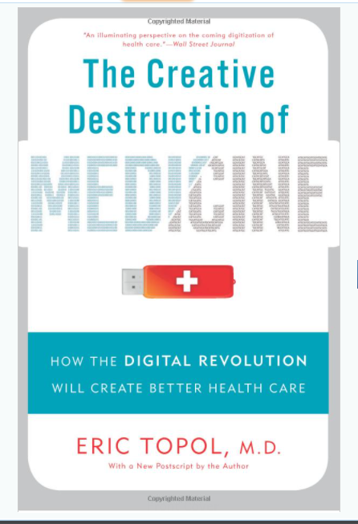
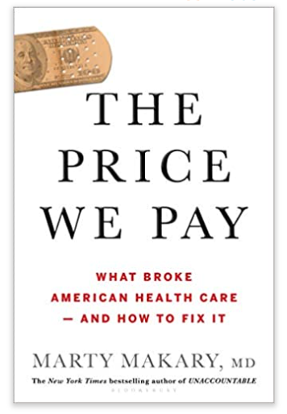
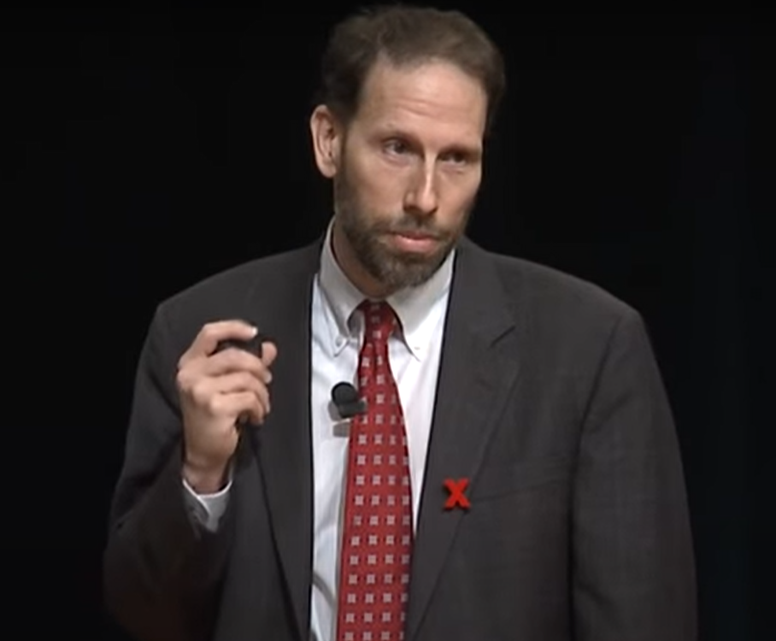
Dr. Marty Makary
Dr. Eric Topol
Dr. Jeffrey Brenner

Slide 3
Hotspots

Slide 4
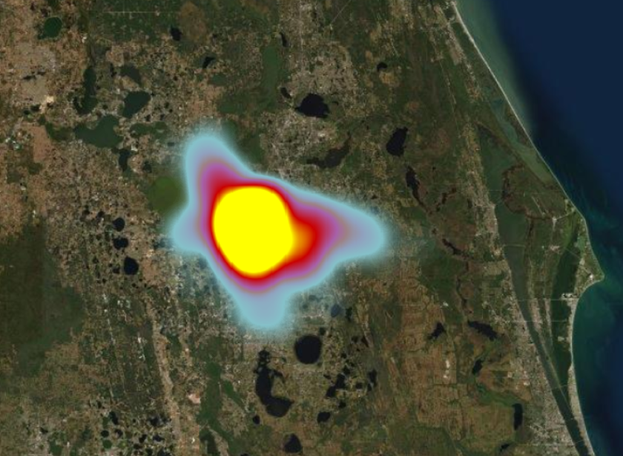
Hotspots and Lots of Data

Slide 5
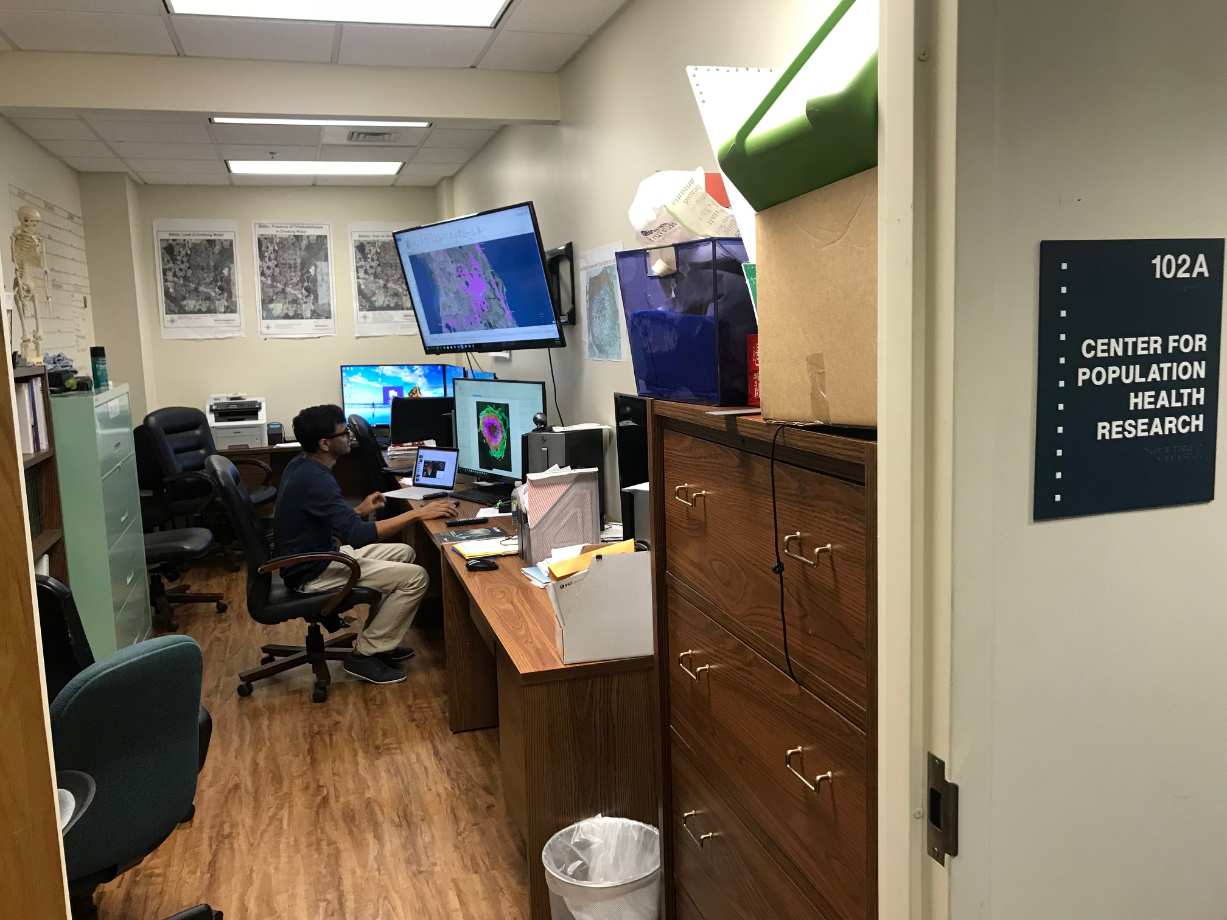
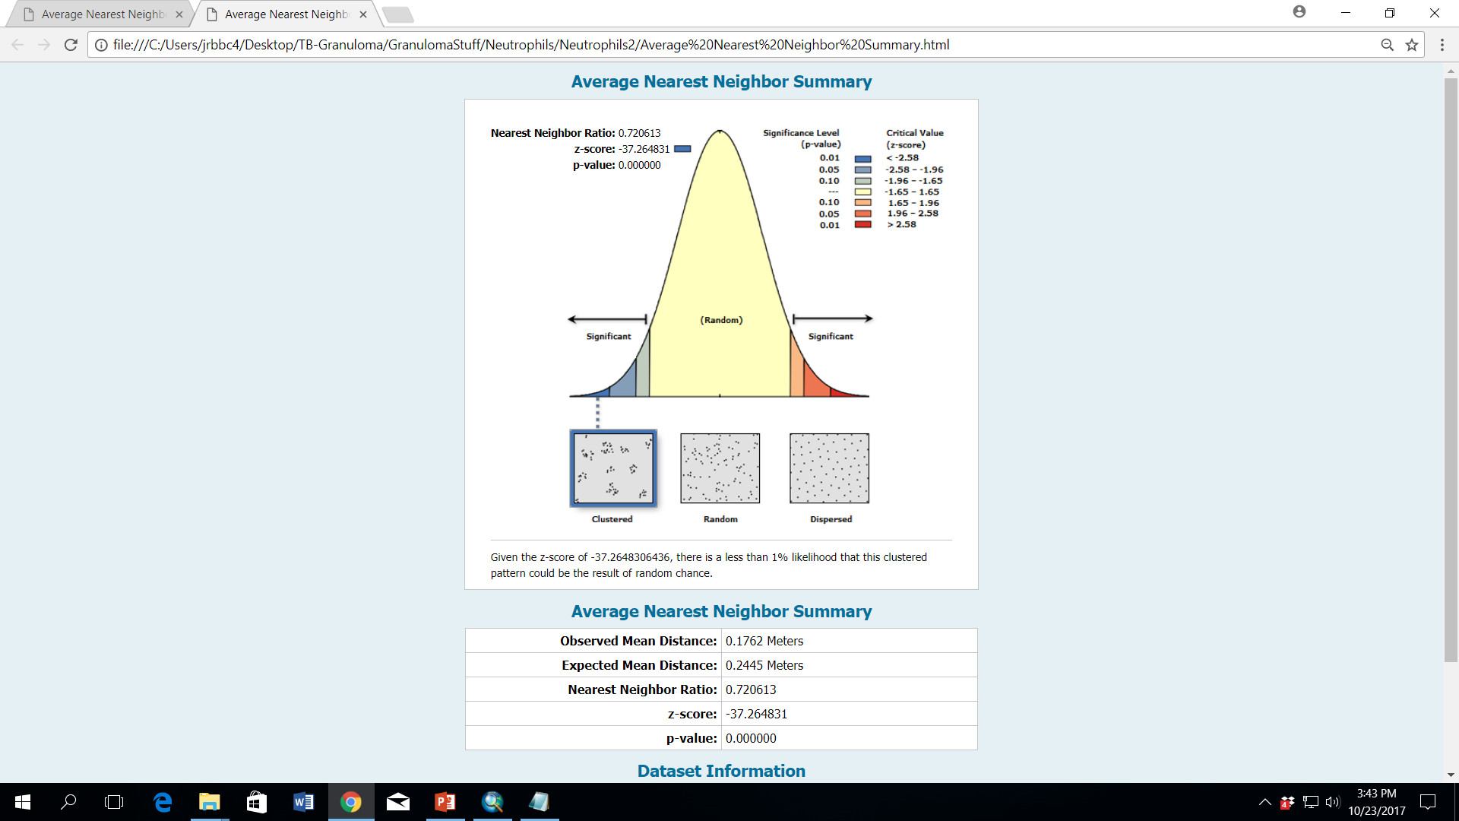
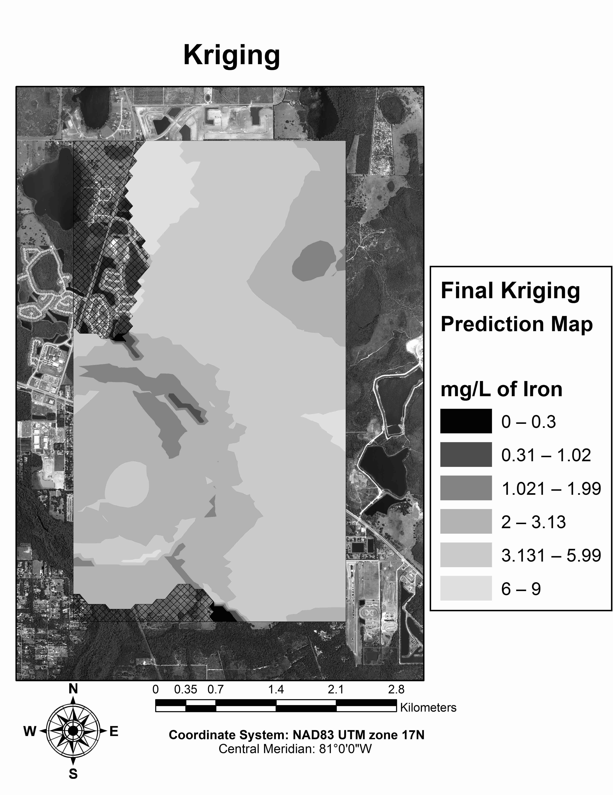
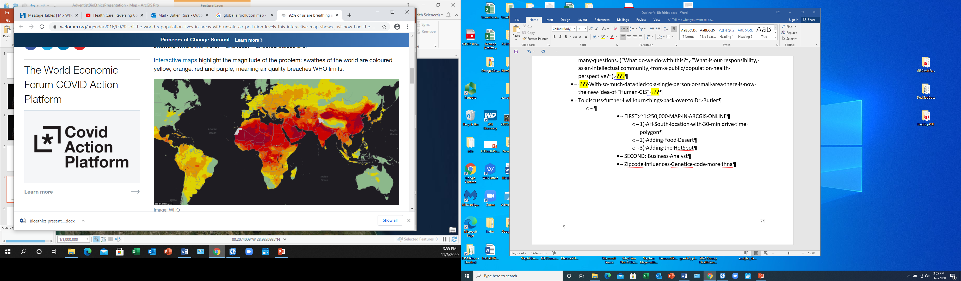
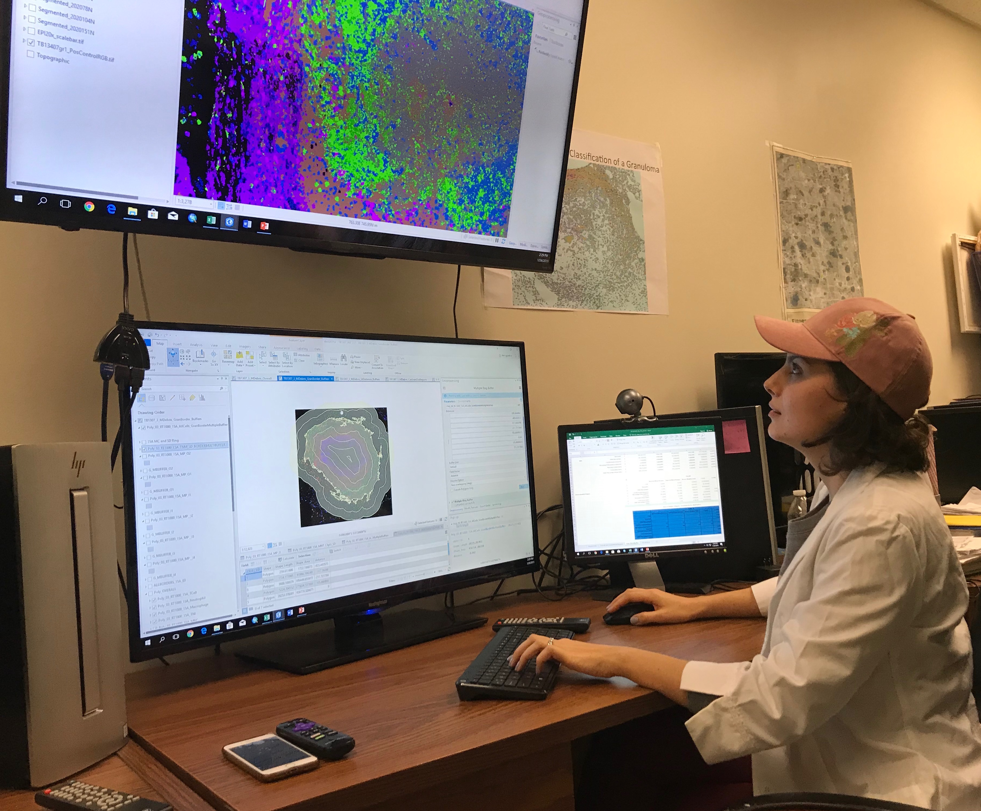
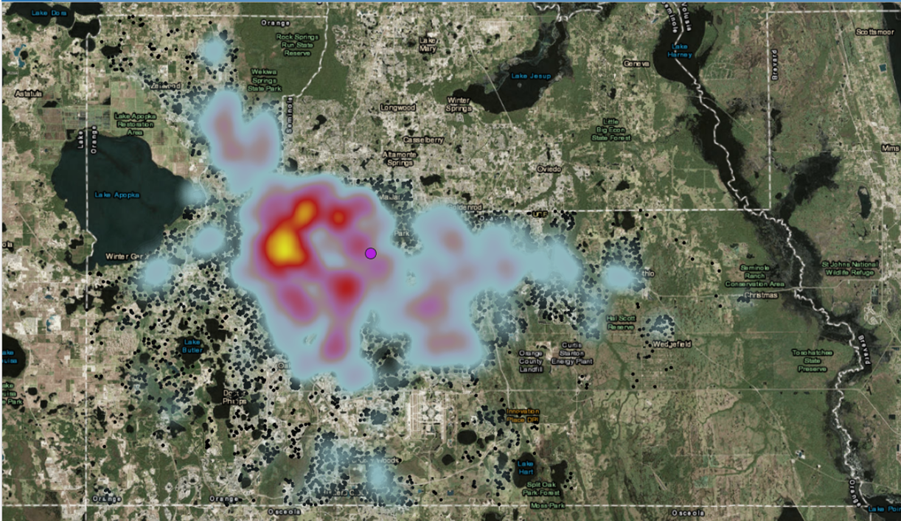
“Big Data:” What Do We Do With IT?
Center for Population Health Research
Department of Health and Biomedical Sciences
J. Russ Butler & Craig Gillen
ArcPro 2.6; ESRI

Slide 6
THANK YOU!

